Slide 1
Biological variation is more than random noise
Bernhard Voelkl
University of Bern

Slide 2
Replication of key studies in biomedical research
N=67
N=53
Prinz et al. 2011, Nature Reviews Drug Discovery Begley & Ellis 2012, Nature
Notes:
24 and 6 successful replications

Slide 3
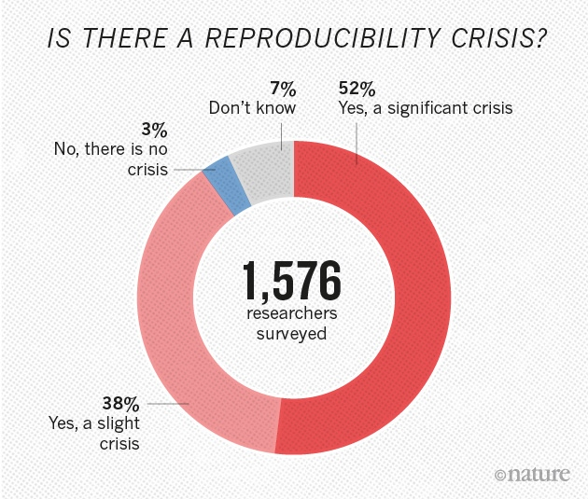
Survey by the journal Nature
Baker, M. 2016, Nature News
Notes:
Monya Baker asked

Slide 4
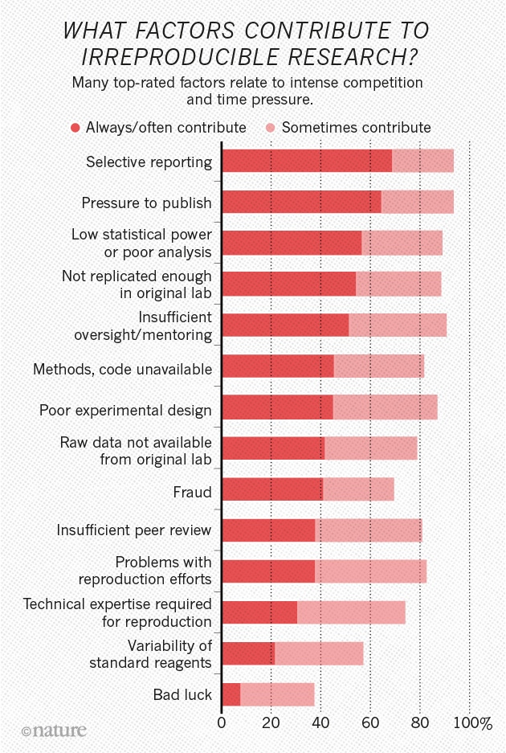
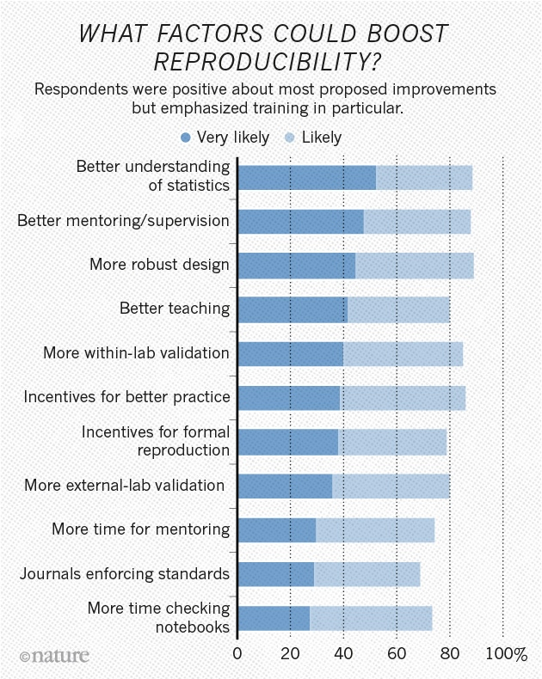
Baker, M. 2016, Nature News

Slide 5
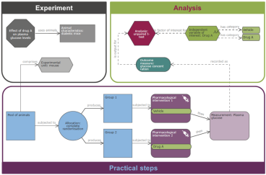
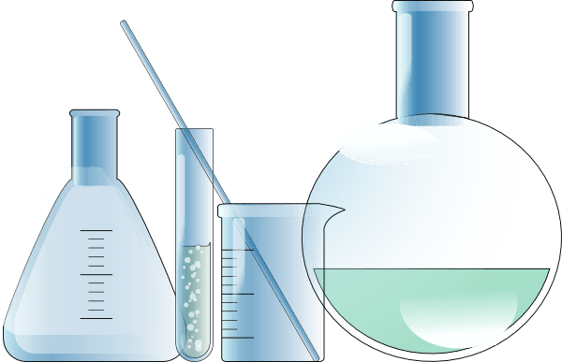
Pre-Clinical Research:
Validity of animal model
Variation in animal model
?
Study Design
Reagents
Model
Measurement
Analysis
Publication

Slide 6
Biological variation is more than random noise
Phenotype differences:
Genes
Strains (C57BL/6, DBA, ..)
Individual differences
Sex
Environment
G × E Interaction
Lab mouse ≠ lab mouse
Notes:
Inbreeding Coefficient >99%

Slide 7
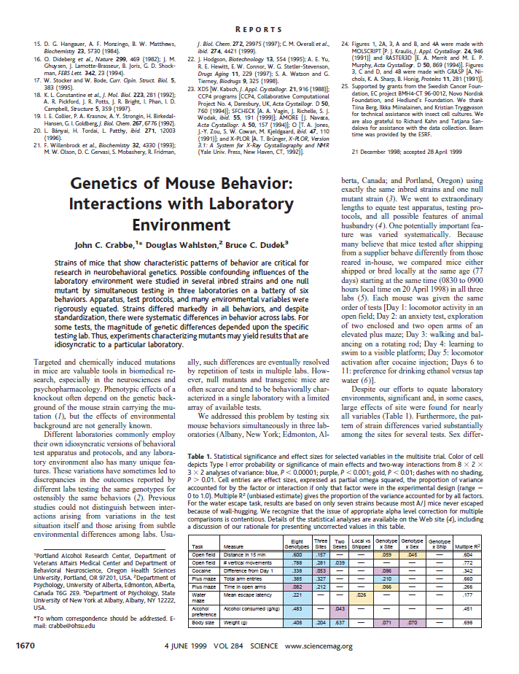
Lab differences despite standardization
Genetics of Mouse Behavior: Interactions with Laboratory Environment
Crabbe et al. 1999, Science
Standardization:
«We went to extraordinary lengths to equate test apparatus, testing protocols, and all possible features of animal husbandry»
Variables explicitly equated across laboratories included: apparatus, exact testing protocols, age of shipped and laboratory-reared mice, method and time of marking before testing, food, bedding, stainless steel cage tops, four to five mice per cage, light/dark cycle, cage changing frequency and specific days, male left in cage after births, culling only of obvious runts, postpartum pregnancy allowed, weaned at 21 days, specific days of body weight recording, and gloved handling without use of forceps. Unmatched variables included local tap water, requirement of filters over cage tops in Portland only, variation of physical arrangement of colonies and testing rooms across sites, different air handling and humidity, and different sources of batches of cocaine and alcohol.

Slide 8
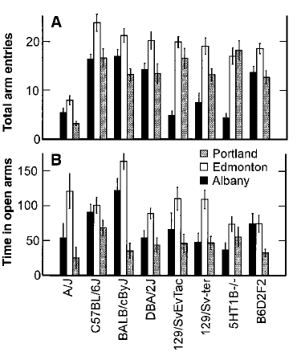
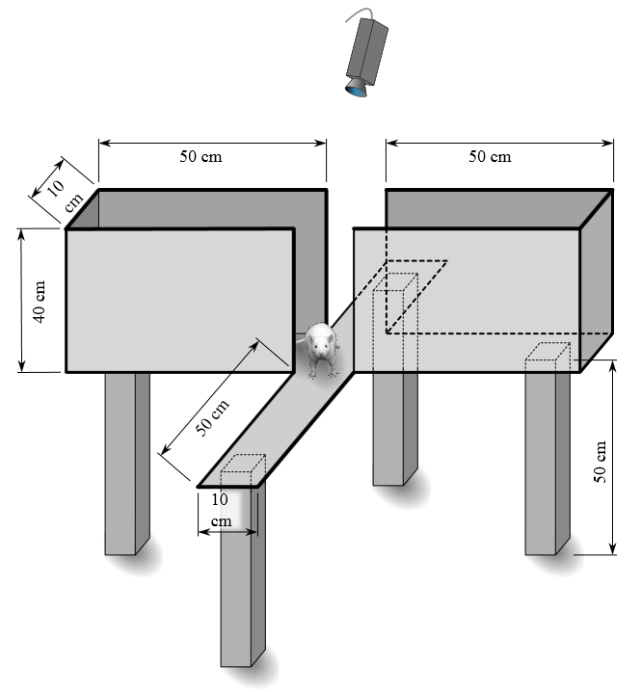
Lab differences despite standardization
Genetics of Mouse Behavior: Interactions with Laboratory Environment
Crabbe et al. 1999, Science
By Samueljohn.de - Own work, CC BY-SA 3.0, https://commons.wikimedia.org

Slide 9
Lab differences despite standardization
Genetics of Mouse Behavior: Interactions with Laboratory Environment
Crabbe et al. 1999, Science
1
A/J
C57BL/6J

Slide 10
Lab differences despite standardization
Genetics of Mouse Behavior: Interactions with Laboratory Environment
Crabbe et al. 1999, Science
Edmonton
2
Albany

Slide 11
Lab differences despite standardization
Genetics of Mouse Behavior: Interactions with Laboratory Environment
Crabbe et al. 1999, Science
5HT1B
B6D2F2
3

Slide 12
The norm of reaction: an evolutionary concept
Trait
Norm of reaction
E(Y)_{X1}
E(Y)_{X2}
Environmental parameter X
Reaction Norm:
Function describing the relationship between an environmental parameter and the expected value for a specific trait for one genotype.

Slide 13
The norm of reaction: an evolutionary concept
Trait
Norm of reaction
E(Y)_{X1}
E(Y)_{X2}
Environmental parameter X
Trait
Norm of reaction:
function describing the relationship between an environmental parameter and the expected value for a specific trait for one genotype.
Environmental parameter X

Slide 14
Multi-laboratory studies: Diversifying the environment
Norm of reaction
Trait
Lab0
Environmental parameter X

Slide 15
Multi-laboratory studies: Diversifying the environment
Norm of reaction
Trait
Lab0
Lab1
Environmental parameter X

Slide 16
Multi-laboratory studies: Diversifying the environment
Norm of reaction
Trait
Lab4
Lab6
Lab3
Lab2
Lab5
Environmental parameter X

Slide 17
Multi-laboratory studies: Diversifying the environment
Norm of reaction
Trait
Lab7
Environmental parameter X

Slide 18
Multi-laboratory studies: Diversifying the environment
Norm of reaction
Trait
Lab10
Lab12
Lab8
Lab9
Lab11
Environmental parameter X

Slide 19
Multi-laboratory studies
Set | Treatment | Measure | # Studies | Disease
1 | tPA | Infarct Volume | 57 | Stroke
2 | Trastuzumab | RX since Xmm3 | 58 | Breast Cancer
3 | FK506 | Infarct Volume | 31 | Stroke
4 | Rosiglitazone2 | Infarct Volume | 21 | Stroke
5 | IL1-RA | Infarct Volume | 36 | Stroke
6 | Hypothermia | Infarct Volume | 98 | Stroke
7 | Cardiosphere DC | EF (%) | 35 | Myocard Infarct
8 | Tirilazad | Infarct Volume | 17 | Stroke
9 | Estradiol | Infarct Volume | 24 | Stroke
10 | Human MSC | Infarct Volume | 26 | Stroke
11 | MK801 | Infarct Volume | 30 | Stroke
12 | TMZ | Volume | 26 | Glioma
13 | Ckit CSC | EF (%) | 25 | Myocard Infarct
14 | Rat BMSC | Infarct Volume | 25 | Stroke

Slide 20
Multi-laboratory studies
1 Lab
2 Labs
3 Labs
4 Labs
Simulated studies
Scaled means difference
N=12
Coverage probability
Coverage probability
False negative rate
N=24
N=48
Number of labs
Widths of CI₉₅
Number of labs
Including 2 - 4 laboratories increased coverage probability by up to 42 % without a need for larger sample sizes.

Slide 21
The Standardization Fallacy
Excessive standardization of every aspect of the study subject will lead to idiosyncratic results that cannot be reproduced under even slightly different conditions.
H. Würbel

Slide 22
Diversity of study samples and external validity
A single experiment will never capture the full diversity in traits and responses to treatments existing in any animal model.
Highly standardized single-laboratory studies are therefore a source of poor reproducibility because they ignore biologically important variation.
Multi-laboratory studies (and other ways of creating more diverse study samples) provide effective means to improve reproducibility in bio-medical research.
We have a moral obligation to prevent wasting animals and resources for non-reproducible and hence inconclusive research.

