Slide 1
Towards a more self-correcting science
Simine Vazire
Psychology
UC Davis
ORCID: 0000-0002-3933-9752

Slide 2
do you want to be credible or incredible?
Simine Vazire
Psychology
UC Davis
ORCID: 0000-0002-3933-9752

Slide 3
disclosures
National Science Foundation grant
Templeton Foundation grant
Editorial stipends
Honoraria for talks (total of about $2,000/year)
Travel to conferences/colleges (including this one)
Notes:
I’ll be sharing some thoughts and ideas based on my experience as social/personality, editor, etc.
Amateur sociology and philosophy of science, very interested in how to develop these ideas into more rigorous, testable predictions.

Slide 4
overview
How do we know when to trust a scientific claim?
Scientific method
Critical evaluation
Authority
Culture
When a research culture goes wrong
What are the indicators of a credible research culture?
Challenges for meta-science

Slide 5
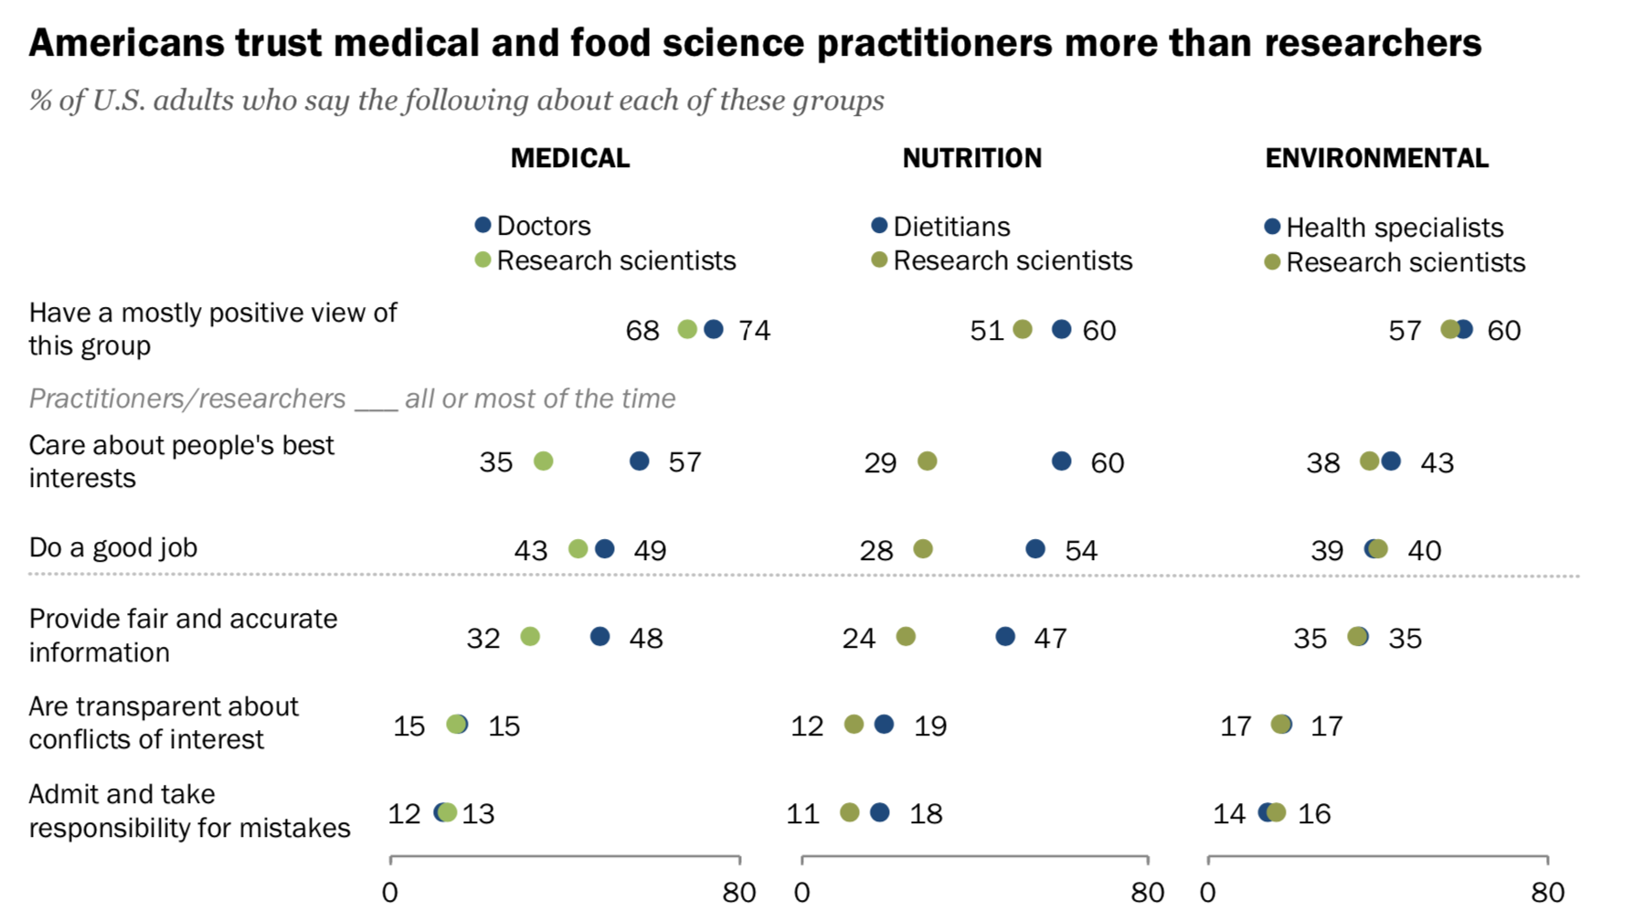
Pew Research Center (2019)
Notes:
People don’t trust individual scientists

Slide 6
And yet…
Pew Research Center (2019)
Notes:
People trust science quite a bit.

Slide 7
why trust science?
“Scientists have a kind of cultural collective distrust, this kind “show me” culture.”
-Naomi Oreskes (2014)
“an internal social organization that […] helps keep most scientists, most of the time, reasonably honest.”
-Susan Haack (2003)

Slide 8
Why trust science?
“The resulting dependability of reports […] comes from a social process rather than from dependence upon the honesty and competence of any single experimenter. […]
Organized distrust produces trustworthy reports.”
-Donald Campbell (1984)

Slide 9
Why trust science?
“the existence of strong and rigid self-policing, and self-controlling mechanisms built into scientific communities preventing access by incompetent or dishonest people, allows it to be taken for granted that those who pass through the checks of gatekeepers can be trusted”
-Piotr Sztompka (2007)

Slide 10
overview
How do we know when to trust a scientific claim?
Scientific method
Critical evaluation
Authority
Culture
When a research culture goes wrong
Notes:
What Feynman called cargo cult science

Slide 11
When a research culture goes wrong
Across the social science:
39/100 in RP:P (Psychology)
11/18 in EERP (Economics)
10/13 in Many Labs 1 (Psychology)
14/28 in Many Labs 2 (Psychology)
3/10 in Many Labs 3 (Psychology)
13/21 in Science & Nature (Social Sciences)
2/9 among RRRs (Psychology)
= 89/199 = 45%* replicability rate
= 55%* false discovery rate
* with large uncertainties!

Slide 12
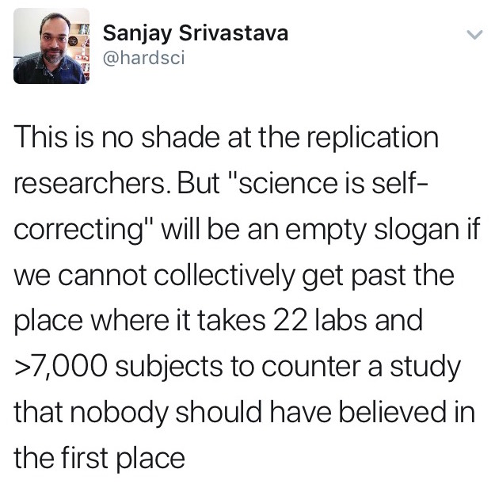
When a research culture goes wrong

Slide 13
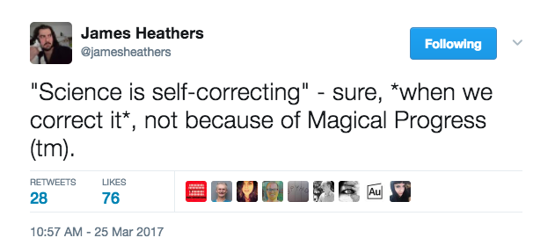
Notes:
We keep saying this, but…. We don’t seem to be living up to it. How do we fix that?

Slide 14
overview
How do we know when to trust a scientific claim?
Scientific method
Critical evaluation
Authority
Culture
When a research culture goes wrong
What are the indicators of a credible research culture?
Notes:
Severe testing idea

Slide 15
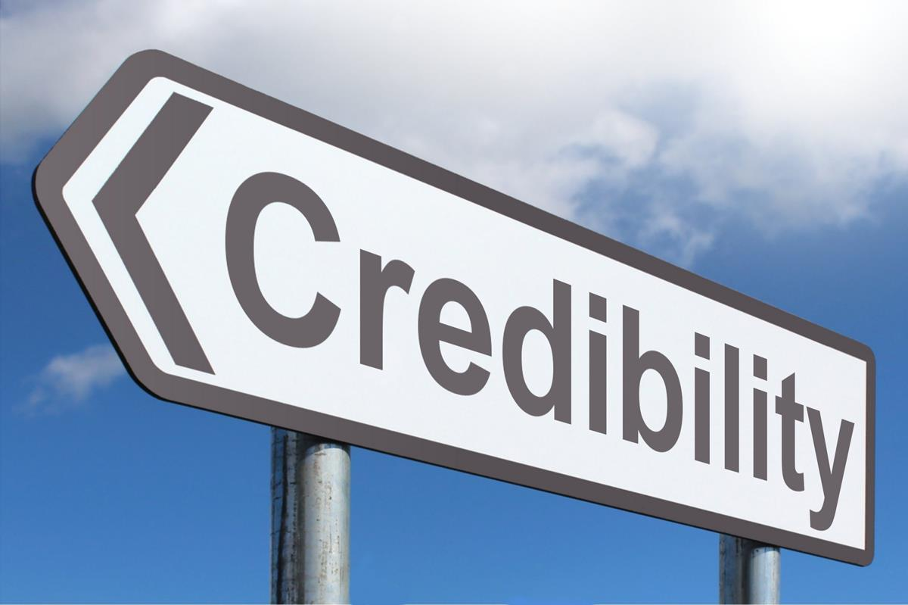
What are the indicators of a credible research culture?
Transparency
Quality control
Calibration
Notes:
So the question is, do you want to be credible, or incredible?

Slide 16
What are the indicators of a credible research culture?
Transparent methods
Pre-registration
Declaration of COIs
Contributions are credited
Papers as advertisements
“Take my word” culture
Appeals to authority/flair
Few people get all the glory
Notes:
Step 1: transparency
Transparent methods = open data, materials, etc.
Appeals to authority/fair = if it’s popular it must be true

Slide 17
Consider the practical consequences for a researcher who eagerly accepts the message of ethical and practical values of sharing and openness, but does not learn about the importance of data quality.
He or she could then just be driving very carefully and very efficiently into a brick wall, conducting transparent experiment after transparent experiment and continuing to produce and publish noise.
Gelman (2017) Honesty and Transparency Are Not Enough

Slide 18
What are the indicators of a credible research culture?
Transparency
Quality control
Notes:
So the question is, do you want to be credible, or incredible?

Slide 19
What are the indicators of a credible research culture?
Transparent methods
Pre-registration
Declaration of COIs
Contributions are credited
Direct replications/audits
Null findings reported
Few unforced errors
Open review
Papers as advertisements
“Take my word” culture
Appeals to authority/flair
Few people get all the glory
All novelty all the time
Everything is significant
Many unforced errors
Blind faith in peer review
Notes:
Audits could mean reproducing results from same dataset, simulations, etc.; RED TEAM
Unforced errors = statcheck, grim, bad p-curve, etc.

Slide 20
What are the indicators of a credible research culture?
Transparency
Quality control
Calibration
Notes:
Let’s assume you have a warranted claim – you did everything in a transparent way and with quality control. There’s still one more way you can go wrong – exaggeration.

Slide 21
What are the indicators of a credible research culture?
Transparent methods
Pre-registration
Declaration of COIs
Contributions are credited
Direct replications/audits
Null findings reported
Few unforced errors
Open review
Post-pub peer review
Corrections
Papers as advertisements
“Take my word” culture
Appeals to authority/flair
Few people get all the glory
All novelty all the time
Everything is significant
Many unforced errors
Blind faith in peer review
Flashy press releases
Emphasis on impact/fame
Notes:
PPPR especially for wide dissemination; VORP instead of impact
THESE ARE NOT INDIVIDUAL ACTIONS. Journals, societies, etc. should invest money, e.g., in auditing, holding journals accountable, better policies (e.g., open review).

Slide 22
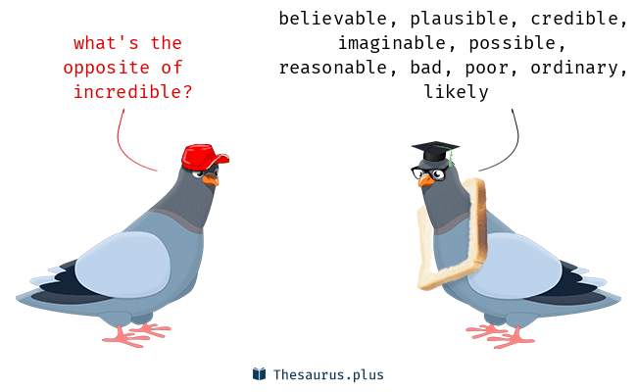
Notes:
Do you want to be credible, or incredible?
Why is there a piece of toast around his neck?

Slide 23
overview
How do we know when to trust a scientific claim?
Scientific method
Critical evaluation
Authority
Culture
When research culture goes wrong
What are the indicators of a credible research culture?
Challenges for meta-science

Slide 24
Challenges for meta-science
Provide metrics about research cultures..
What should we measure and how?
What do we do when metrics get gamed?
How do we communicate this information?
… so that we (and outsiders) can answer the question:
How do different fields and subfields differ in their cultures?
Which fields are more credible?
Notes:
Metrics: some will be really hard, e.g., measuring the amount of hype in a paper. Or whether causal claims are warranted.
Comparing fields: Imagine a world where fields compete not just for attention and money, but for higher rankings on these metrics.

Slide 25
Let’s start now
A sign of a credible field is
“how far conferences manage to be occasions for genuine communication and mutual education rather than mere self-promotion and networking”
-Susan Haack (2003)
Notes:
If we want to create a more credible research culture, we can start right here, today.

Slide 26
The end

Slide 27
How do we know when to trust a scientific claim?
A: Because the scientists used “the scientific method” (hypothetico-deductive method)
Three problems (Oreskes, 2014)
False theories can make true predictions
Auxiliary hypotheses are necessary
Many scientific discoveries* didn’t follow from this method
Notes:
When a journal asked scientists what is the most important method in their field, Georges Sorel said “honesty”

Slide 28
overview
How do we know when to trust a scientific claim?
Scientific method
Critical evaluation

Slide 29
How do we know when to trust a scientific claim?
A: Use your reasoning skills!

Slide 30
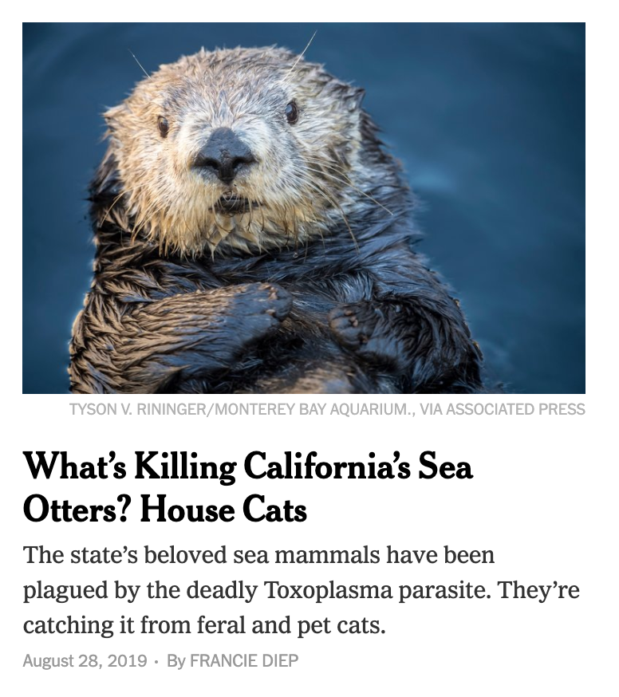
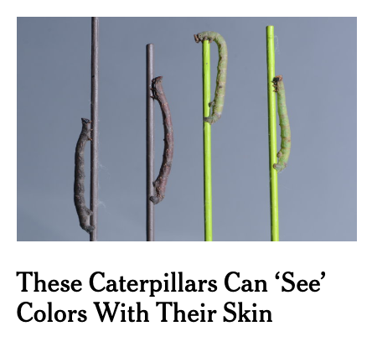
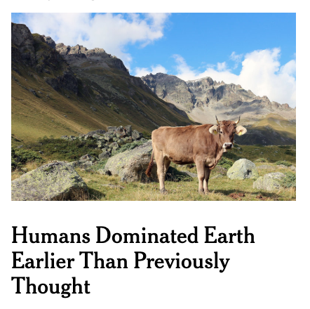
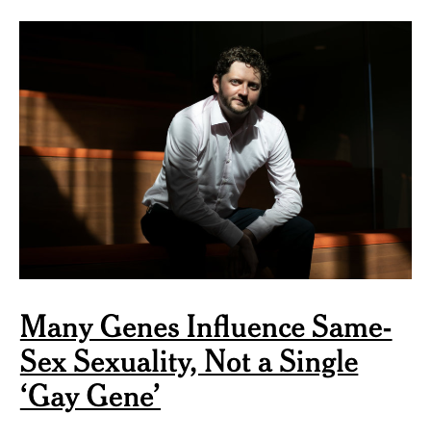
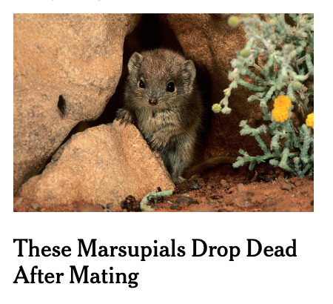
How do we know when to trust a scientific claim?
Notes:
We can’t evaluate the validity of claims outside our own area of expertise. These are all from the last few weeks.

Slide 31
overview
How do we know when to trust a scientific claim?
Scientific method
Critical evaluation
Authority

Slide 32
How do we know when to trust a scientific claim?
“Here’s the paradox of modern science. […]
Actually science is the appeal to authority. But it’s not the appeal to the authority of the individual […] it’s the authority of the collective community.”
-Naomi Oreskes (2014)

Slide 33
How do we know when to trust a scientific claim?
A: When the collective community has decided it’s warranted.
The authority of the collective community means…
It’s been peer reviewed?

Slide 34
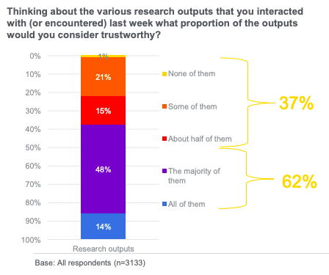
Elsevier “Trust in Research” survey (2019)
Notes:
37% of scientists surveyed trusted half or less of the research outputs they saw in the last week.

Slide 35
How do we know when to trust a scientific claim?
A: When the collective community has decided it’s warranted.
The authority of the collective community means…
It’s been peer reviewed?
There’s consensus among experts?

Slide 36
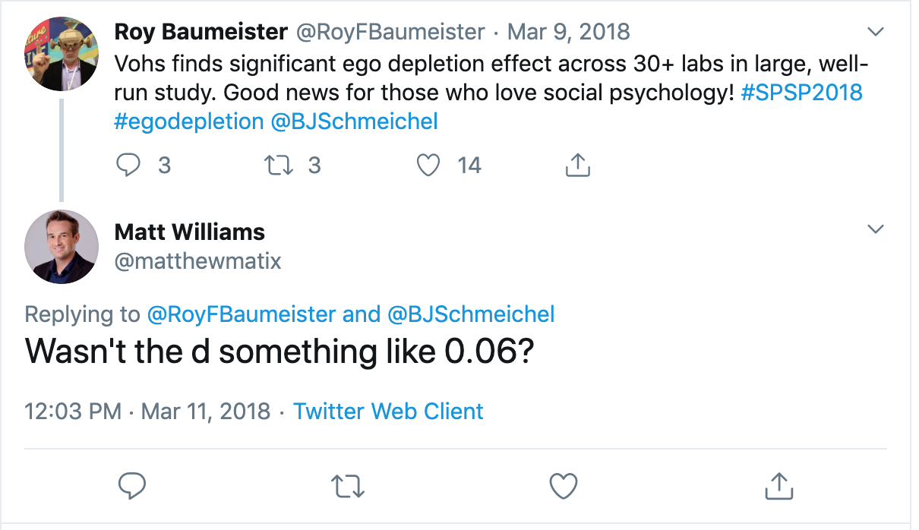
“I’m tired of seeing so much time and money spent on replicating ridiculous studies.”

Slide 37
How do we know when to trust a scientific claim?
A: When the collective community has decided it’s warranted.
The authority of the collective community means…
It’s been peer reviewed?
There’s consensus among experts?
It’s in the textbooks?

Slide 39
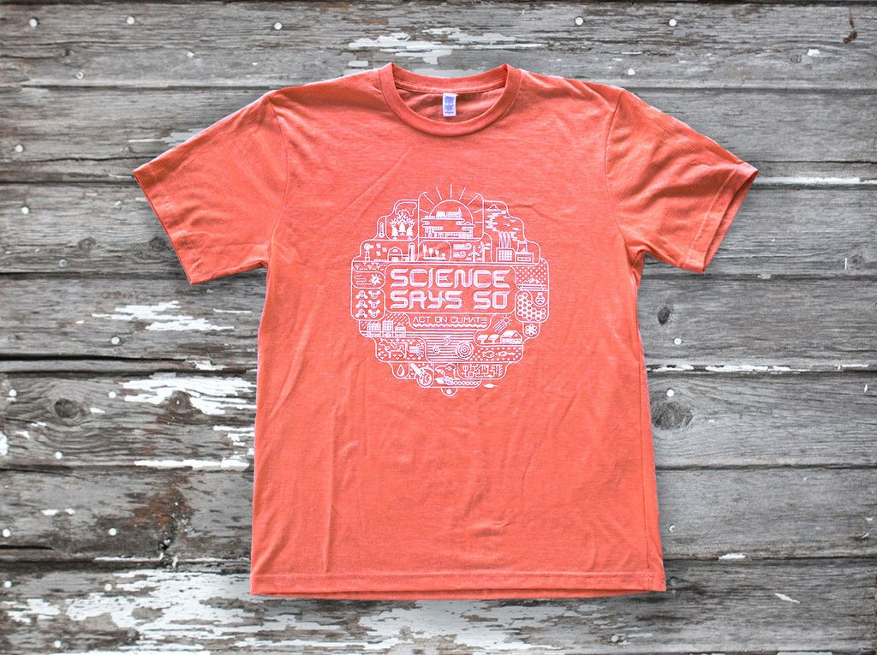
Notes:
I used to own and wear this t-shirt. I’m embarrassed now.

Slide 40
overview
How do we know when to trust a scientific claim?
Scientific method
Critical evaluation
Authority

Slide 41
How are we doing?

Slide 42
Universalism vs. hierarchy
Scientists evaluate research only on its merit, i.e., according to accepted standards of the field.
Scientists assess new knowledge and its applications based on the reputation and past productivity of the individual or research group.
Communality vs. secrecy
Scientists openly share new findings with colleagues.
Scientists protect their newest findings to ensure priority in publishing, patenting, or applications.
Disinterestedness vs. self-interestedness
Scientists are motivated by the desire for knowledge and discovery, and not by the possibility of personal gain.
Scientists compete with others in the same field for funding and recognition of their achievements.
Organized skepticism vs. organized dogmatism
Scientists consider all new evidence, hypotheses, theories, and innovations, even those that challenge or contradict their own work.
Scientists invest their careers in promoting their own most important findings, theories, or innovations.
Notes:
What does a self-correcting system look like?

Slide 43
Do scientists follow merton’s norms?

Slide 44
How is your field doing?
Scientists assess new knowledge and its applications based on the reputation and past productivity of the individual or research group.
Scientists protect their newest findings to ensure priority in publishing, patenting, or applications.
Scientists compete with others in the same field for funding and recognition of their achievements.
Scientists invest their careers in promoting their own most important findings, theories, or innovations.

Slide 45
SeverE vs. lax fields
“If little has been done to rule out flaws in taking data as evidence for a claim, then that claim has not passed a severe test.” – Deborah Mayo (2018)
Just like severe testing is crucial to statistical inference, a culture of severe evaluation is crucial to a field’s credibility.
A science is only as credible as its self-correcting mechanisms.

Slide 46
calibration
“If we present our resulting improved truth claims as though they were definitive achievements comparable to those in the physical sciences, and thus deserving to override ordinary wisdom when they disagree, we can be socially destructive. We can be engaged in the political misuse of the authority of science that has not been fully earned in our own field.”
-Donald Campbell (1984)
Notes:
Also, we can undermine public trust in (social) science, because the public will see through it, and make appropriate conclusions about the severity in our research culture, or lack thereof

Slide 47
What a time to be a meta-scientist
“The success of the natural sciences […] has been truly extraordinary.
[…]
But, for all that, there are no grounds for complacency. As science gets more expensive, so that only governments and large industrial concerns can afford to support it, as career pressures mount, as opportunities multiply for a scientist to get rich from his discoveries, as the expert-witness business booms, there is no guarantee that the mechanisms which have thus far nourished scientific imagination and sustained respect for evidence will continue to do so.”
-Susan Haack (2003)

